Slide 1
Creative Schools Induction 2021

Slide 2
Context, objectives and priorities of the Creative Schools Initiative

Slide 3
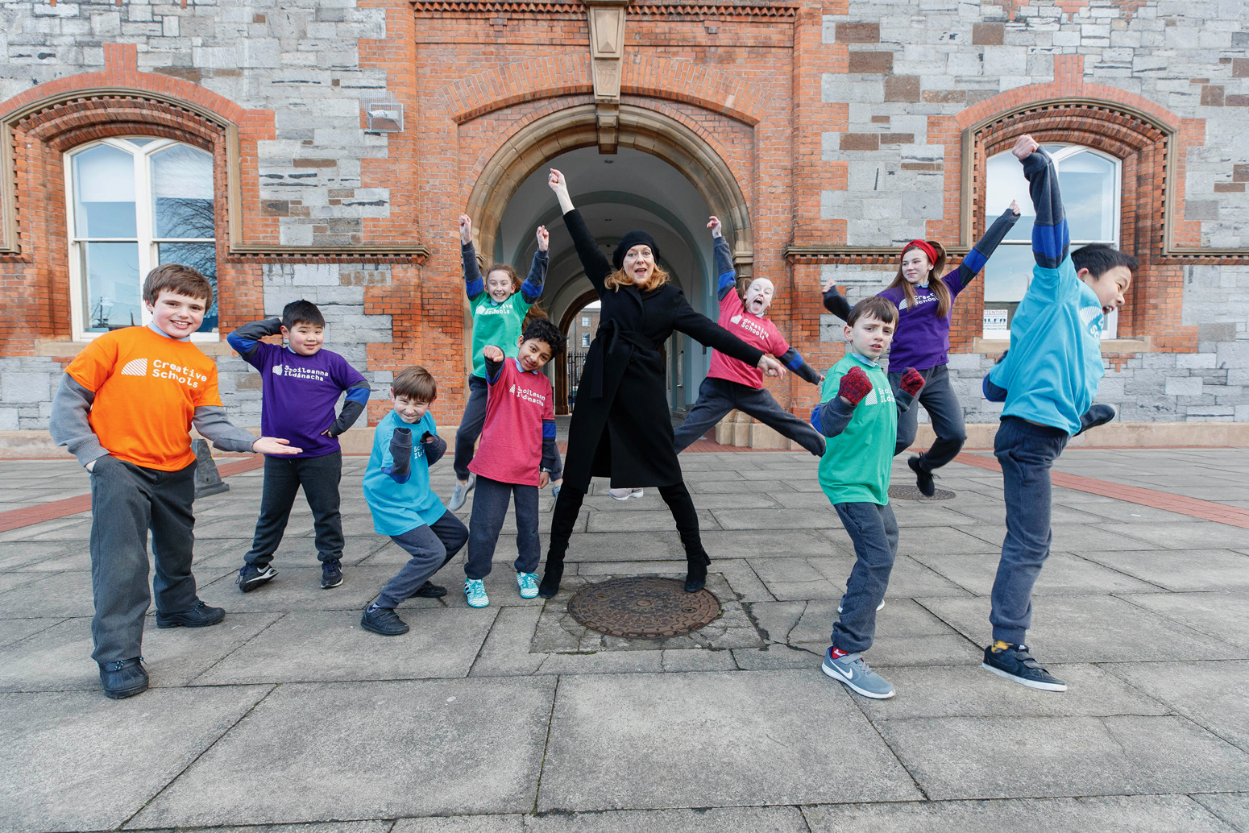
Context – Our partners
Creative Schools is led by the Arts Council in partnership with the Department of Education and Skills and the Department of Tourism, Culture, Arts, Gaeltacht, Sport and Media
Creative Schools is a flagship initiative of Creative Ireland’s Creative Youth Plan.
Notes:
This partnership is significant in that it brings important together departments across Government that have influence on the lives of children and young people.
Creative Schools brings key policies for these departments to life – including the well- being of Children and young people, their access to the arts and culture and their creativity .
The Creative Youth Plan aims to increase opportunities for activity and participation, and to influence public policy around creativity in both formal education and out-of-school settings.
The Department of Children, Equality, Disability, Integration and Youth has become a key partner, supporting the initiative in particular in the area of youth voice.

Slide 4
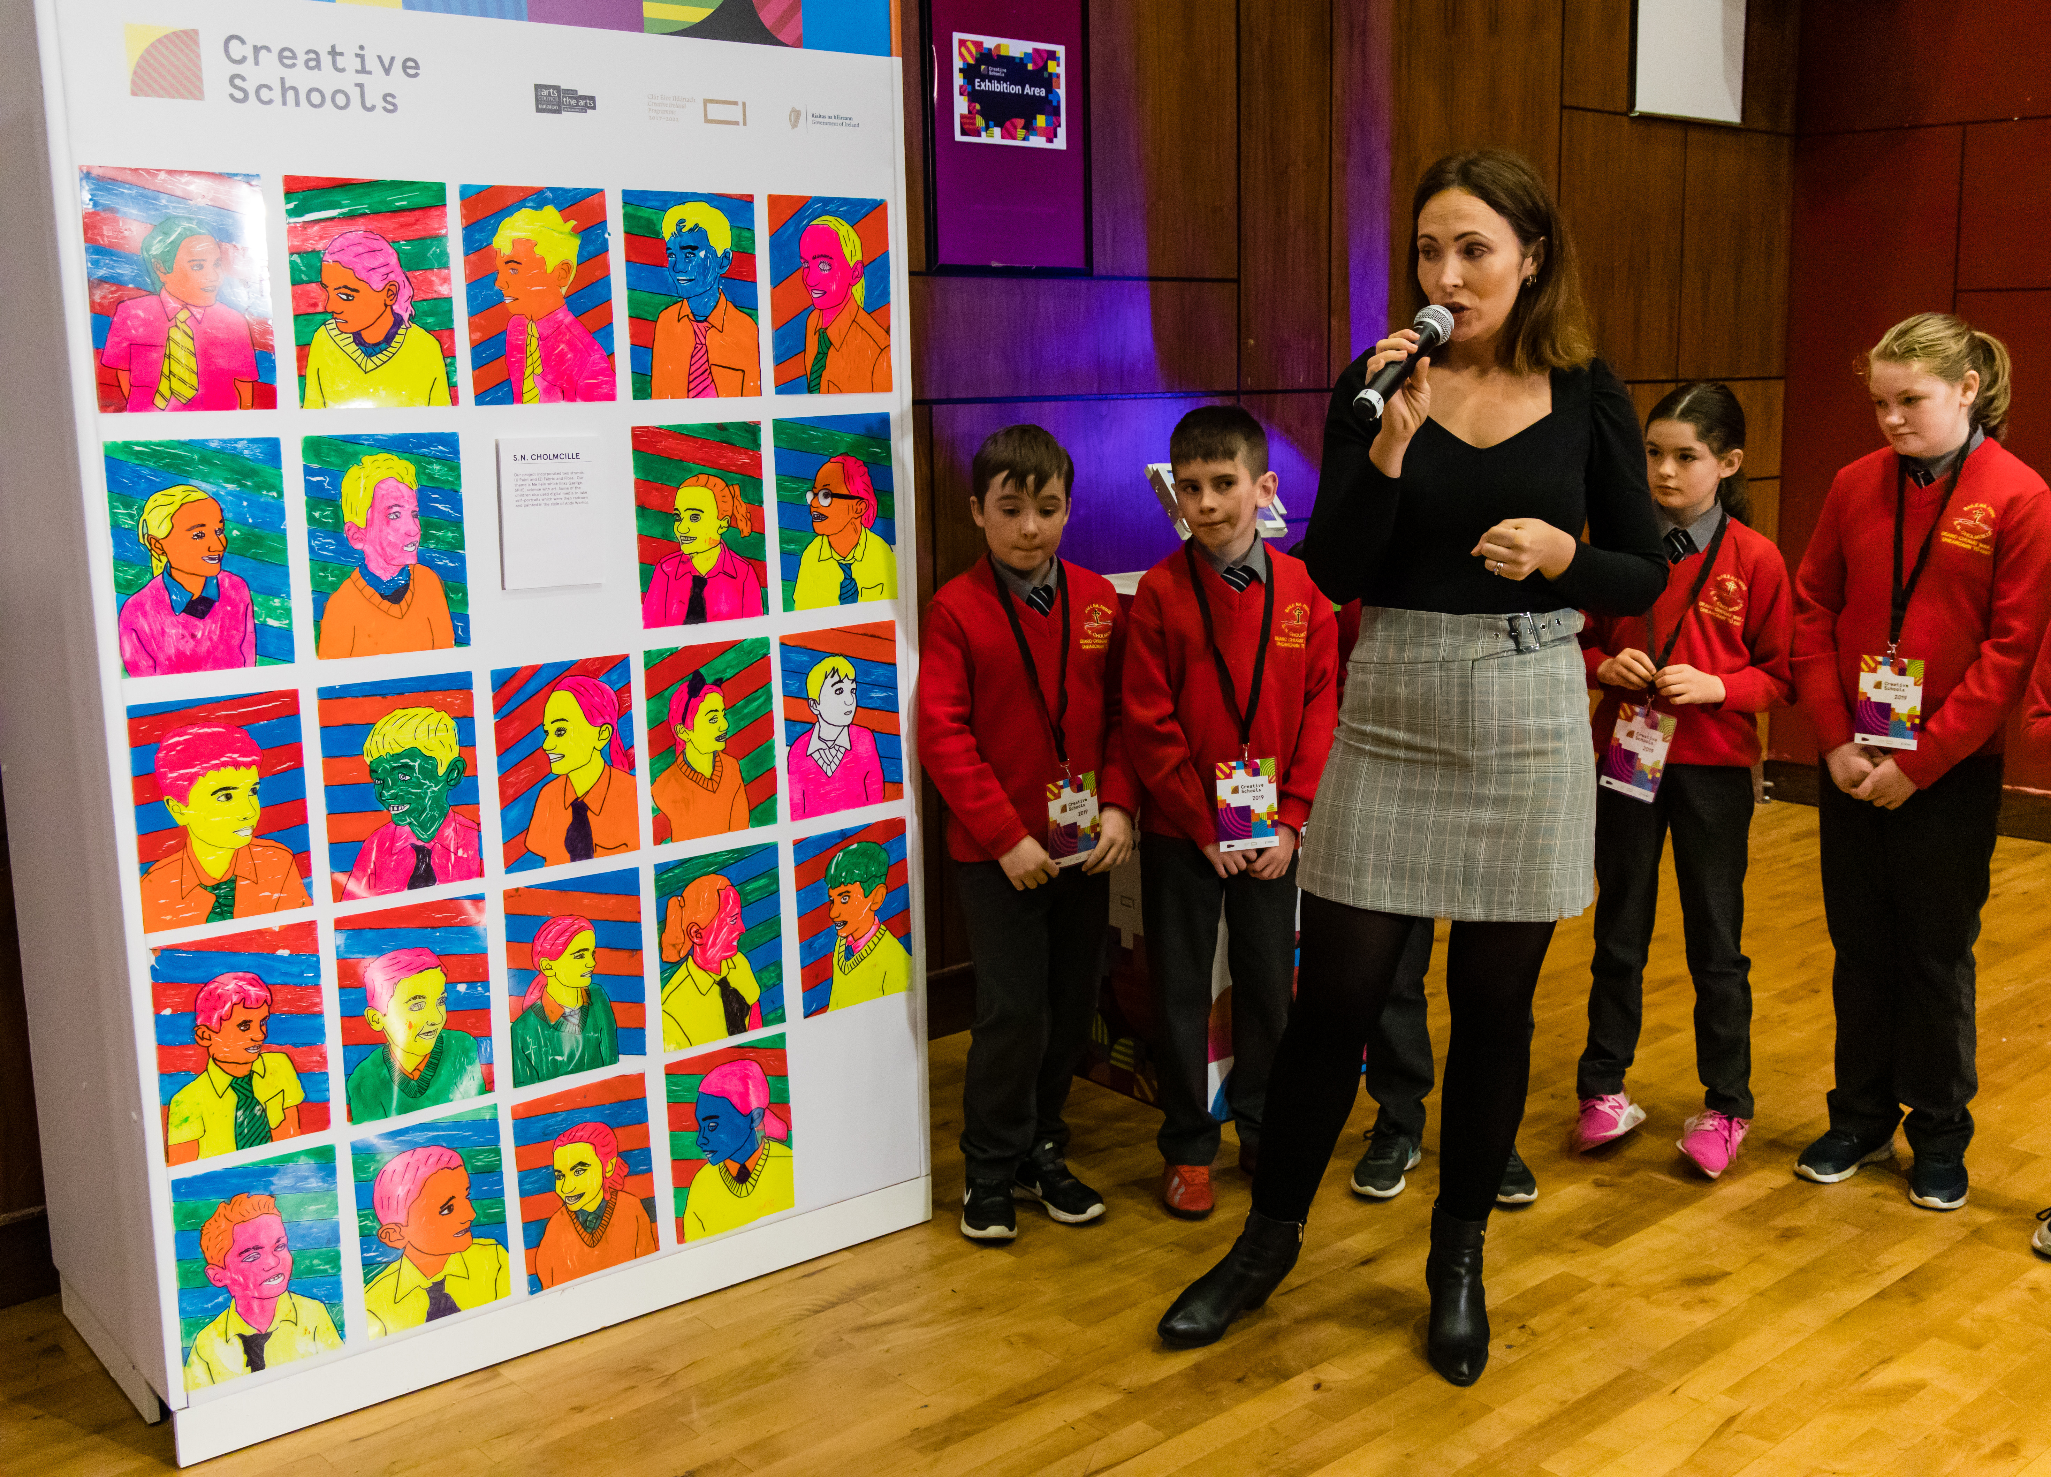
Objectives and priorities of the Creative Schools Initiative
The Creative Schools Initiative:
Supports schools to put the arts and creativity at the heart of children’s and young people’s lives.
Embeds the arts and creativity in teaching and learning; nurturing learners’ sense of agency and self-worth, ensuring a positive experience and strong outcomes for children and young people.
Stimulates additional ways of working in schools that reinforce the impact of creativity on children and young people’s learning, development and well-being.
Develops partnerships and mechanisms that enable sustained relationships between schools and the arts and cultural sectors.
Notes:
Creative Schools is about learning in the arts and learning through the arts - so using creative practices in the arts subjects and across the whole curriculum too.
Schools will draw on the range of resources within their school and wider community, developing new ways of working that reinforce the impact of creativity on student learning, development and well-being.

Slide 5
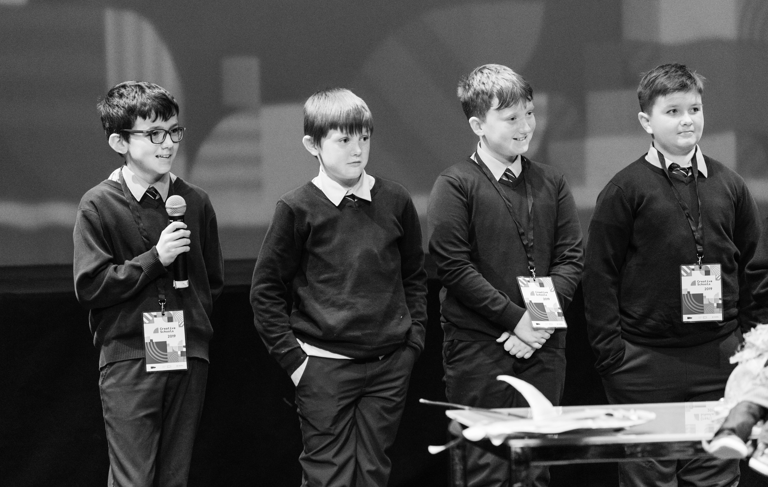
Objectives and priorities of the Creative Schools Initiative
The Creative Schools Initiative:
Provides creative ways to ensure that children and young people have a central role in the Creative Schools process and that their voices are heard.
Empowers children and young people to develop, implement and evaluate arts and creative activity throughout their schools.
Provides opportunities for children and young people to build their artistic and creative skills; to communicate, collaborate, stimulate their imaginations, be inventive, and to harness their curiosity.
Notes:
Central to the Creative Schools initiative is the voice of the children/young people who are involved.

Slide 6
Creative Schools: a whole-school developmental process
Develop your Creative School Plan
Begin to implement your Creative School Plan
Understand
2
1
3
Notes:
How does the Creative Schools initiative deliver these ambitious objectives?
Through schools’ active participation in a developmental process to establish a Creative Schools Plan bespoke to each and every school and Youthreach centre taking part in the programme.

Slide 7
What supports do Creative Schools receive?

Slide 8
What support will Creative Schools receive?
UP TO 9
days of support from a Creative Associate each year for 2 years. The Arts Council contracts and pays the CA.
The total value of this is over two years is €5,400
€4,000
Once-off grant to implement your plans over two school years - 2021-22 and 2022-23.
Virtual training for the School Coordinator and self-directed learning and networking opportunities
Notes:
Creative Schools provides schools with a package of supports that includes working with a Creative Associate, training and networking to support them to create their Creative School Plan, as well as funding to begin to implement their Plan.

Slide 9
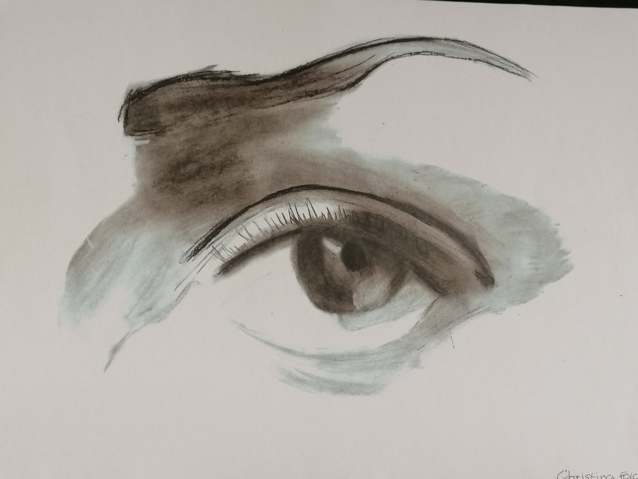
Understanding the role of the Creative Associate
The Creative Associate is there to help, support and advise you at all stages of the Creative Schools journey
They are a critical friend, challenging you to think in new ways
They will work with you to understand and value your starting point as a Creative School
They have specialist knowledge in arts and education and will help deepen the expertise that is already in the school
They will support you to put the arts and creativity at the heart of your school community

Slide 10
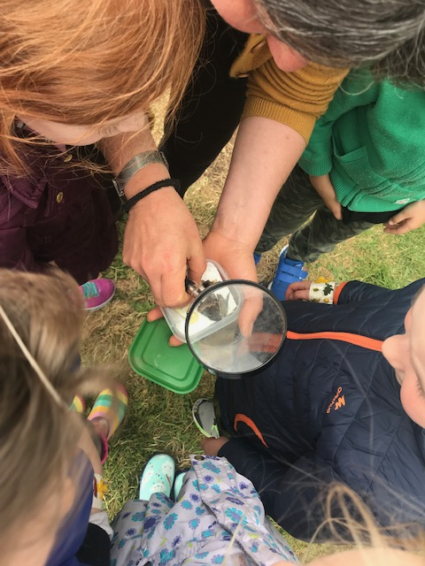
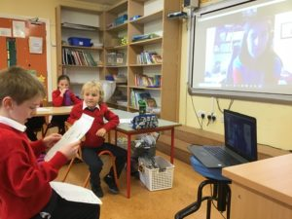
The role of the Creative Associate
They help explore your school’s understanding of creativity
They will facilitate meetings with various stakeholders in the school
They will support you to ensure that the voice of children and young people is central in the Creative School Plan
They help collate findings from the consultation phase
They research local arts and creative opportunities and funding opportunities
They support you to develop a bespoke and sustainable Creative School Plan
They support you with writing up documentation

Slide 11
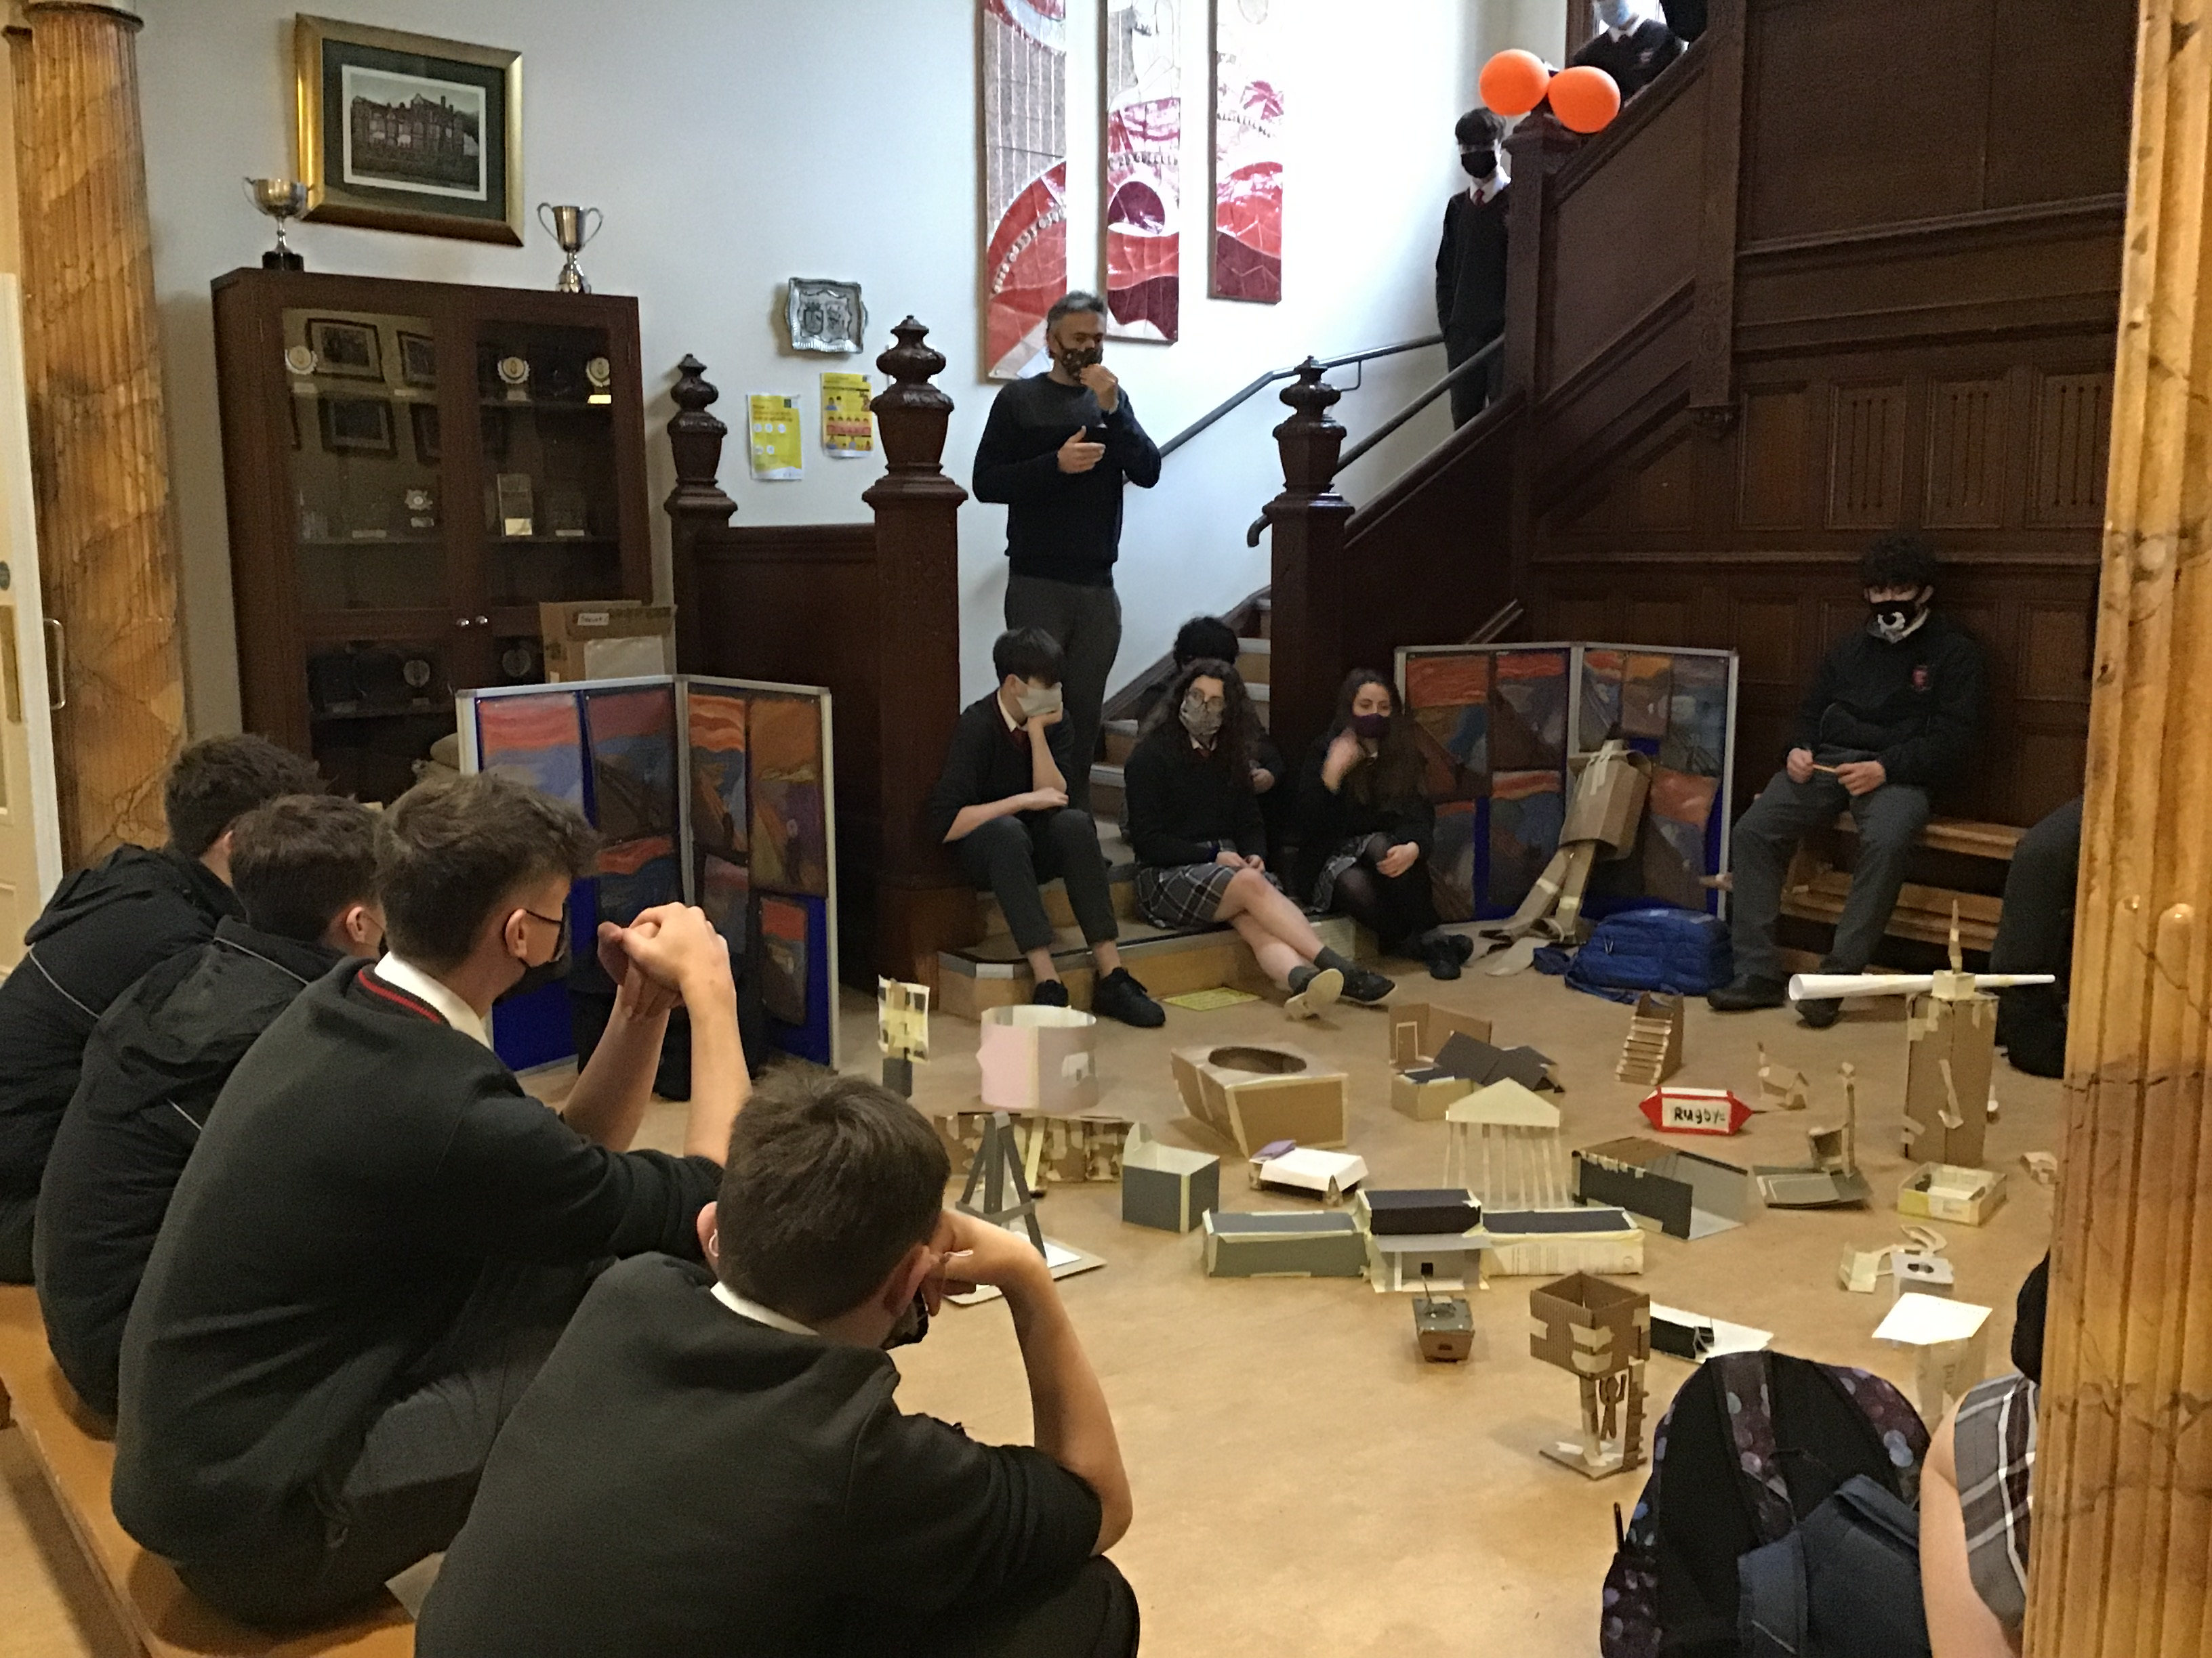
Understanding the role of the CA
Though the Creative Associate may use their creative practice as part of the consultative process with your school, they will not facilitate and deliver projects as artists as part of the implementation of your Creative School Plan.
They will however advise and help to identify others who can.

Slide 12
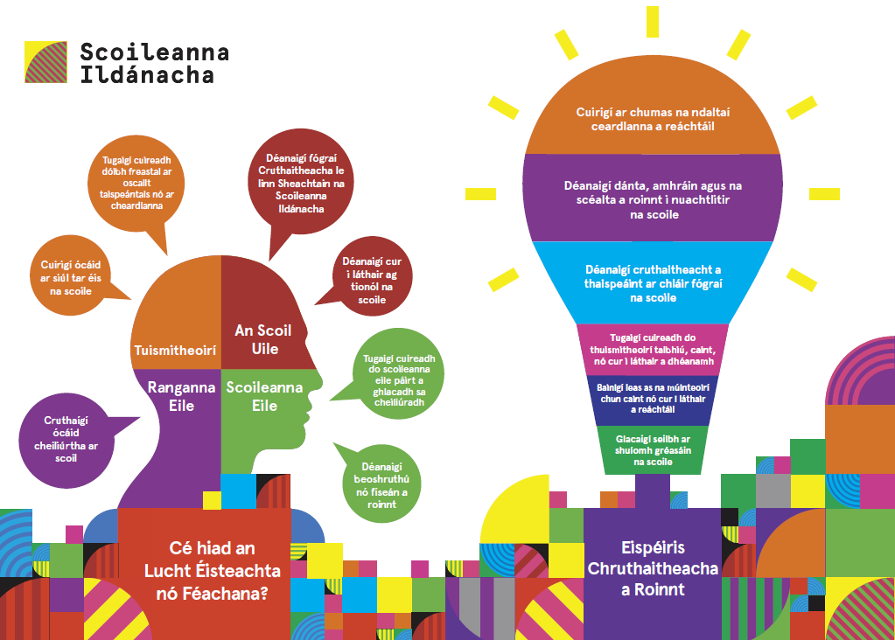
Creative Schools Week 2021
The opportunity to participate in national celebration events, such as Creative Schools Week
Notes:
Running your own Creative Schools Week in your own school is a fantastic way to involve the whole school community and to communicate that you are a Creative School. Your Creative Associate will support you with this process.
Creative Schools will be in touch with more information on this exciting opportunity shortly.

Slide 13
School Commitment

Slide 14
What commitment is required from schools?
The commitment includes:
A willingness to mobilise the school community to engage with the Creative Schools initiative including school leaders, teachers and class groups.
Engaging with the process of designing, delivering and reporting on their Creative School Plan.
Giving children and young people a role in developing, implementing and evaluating the Creative School Plan.
Notes:
It is important that significant time and resources are given to developing, implementing and evaluating your Creative School Plan. This may include drawing on the time of staff, children and young people, families, and the Board of Management.
Information on the role of the School Coordinator is available in the 2021 FAQs (sent to all CAs and SCs and available on the CS website)

